Slide 1


Deep Learning (DL)
Lab6
Natural Language Processing (NLP)
Recurrent Neural Network (RNN)
Long Short-Term Memory(LSTM)
Gated Recurrent Unit (GRU)
Bidirectional LSTM

Slide 2
Deep Learning (DL)
Lab6
Natural Language Processing (NLP)
Recurrent Neural Network (RNN)

Slide 3
Recurrent Neural Networks (RNN)

Slide 4
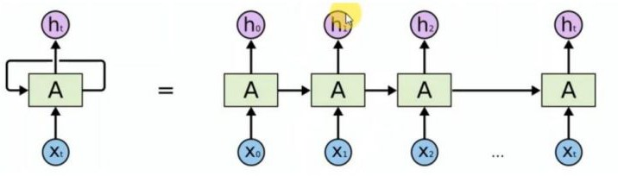
Recurrent Neural Networks (RNN)
It's used with sequential data, and it's based on the element of time, like stock prices or weather data, also the texts, because “she spoke to her husband”, ‘her’ word depends on ‘she’.
RNN looks quite like a traditional NN, except that a memory-state is added to the neurons.
The structure is as follows:
Where the network uses the output as an input again.

Slide 5
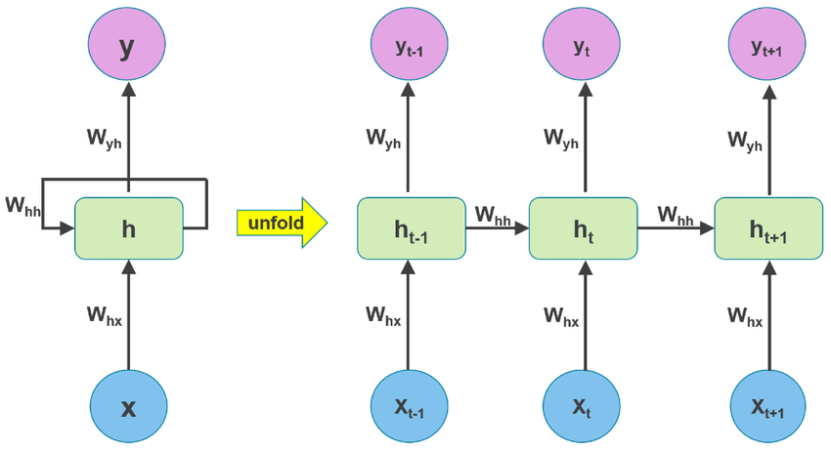
RNN – unrolled in time

Slide 6
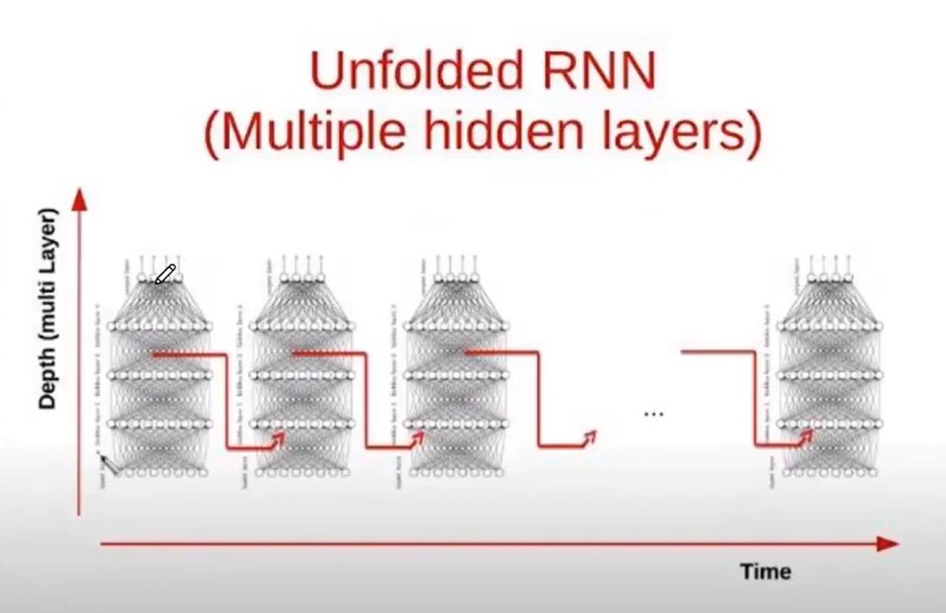

Slide 7
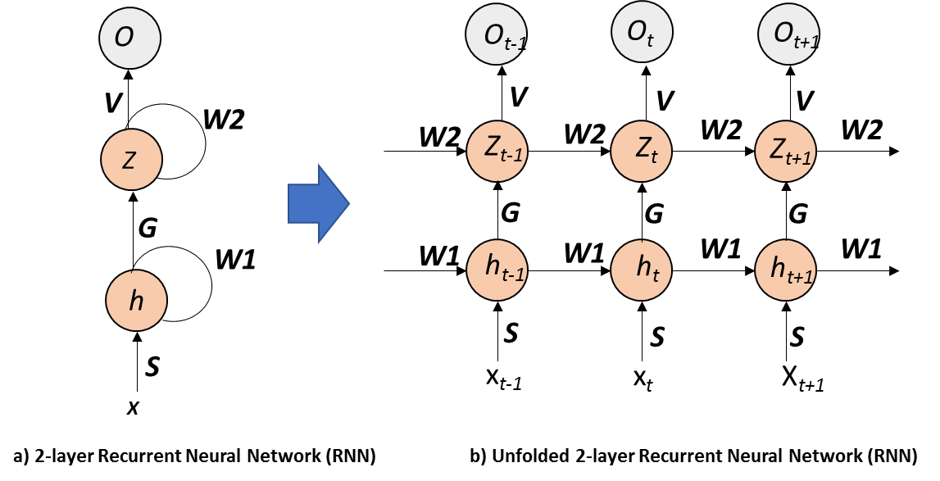

Slide 8
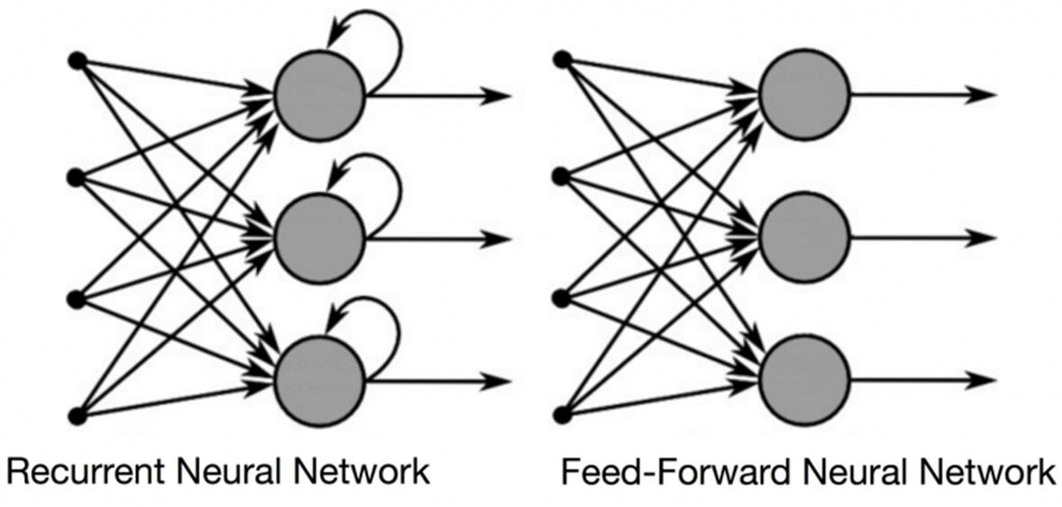
Recurrent Neural Networks (RNN)
64
Let’s give word "Recurrent" as an input to FF-NN and it processes the word character by character.
When it reach to "u," it has already forgotten about "R," "e" and "c," which makes it
impossible for this type of NN to predict which character would come next.
March 28, 2022

Slide 9
Recurrent Neural Networks (RNN)
65
RNN is able to remember those characters because of its internal memory.
It produces output, copies that output and loops it back into the network.
Simply: RNN add the immediate past to the present.
Therefore, a RNN has two inputs: the present and the recent past.
This is important because the sequence of data contains crucial information about what is coming next, which is why a RNN can do while other algorithms can’t.
March 28, 2022

Slide 10
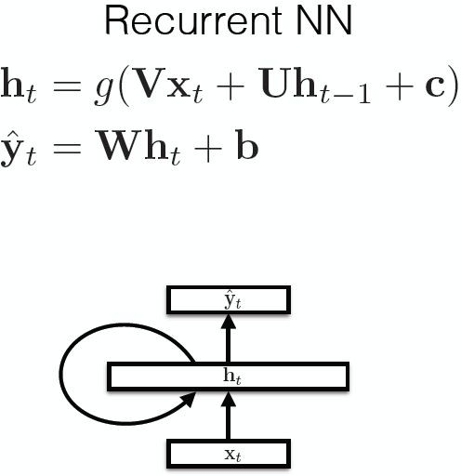
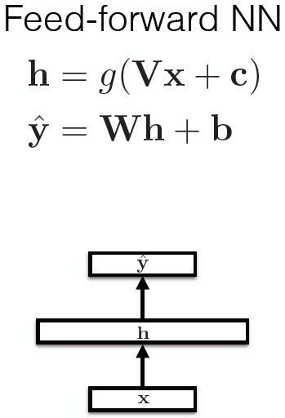
Basic Recurrent Neural Networks (RNN)

Slide 11
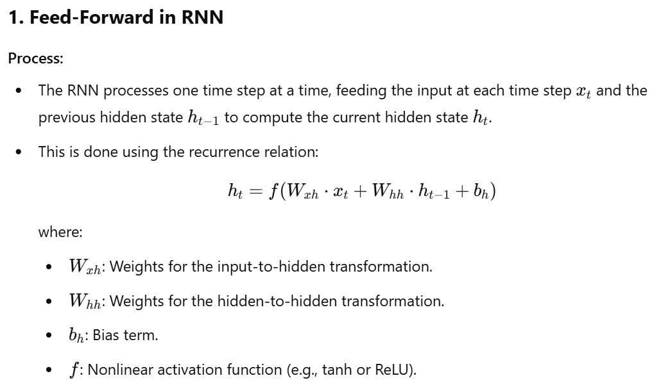
Recurrent Neural Networks (RNN)

Slide 12
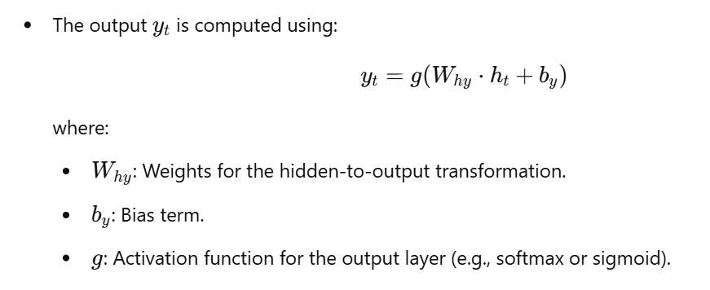
Recurrent Neural Networks (RNN)

Slide 13
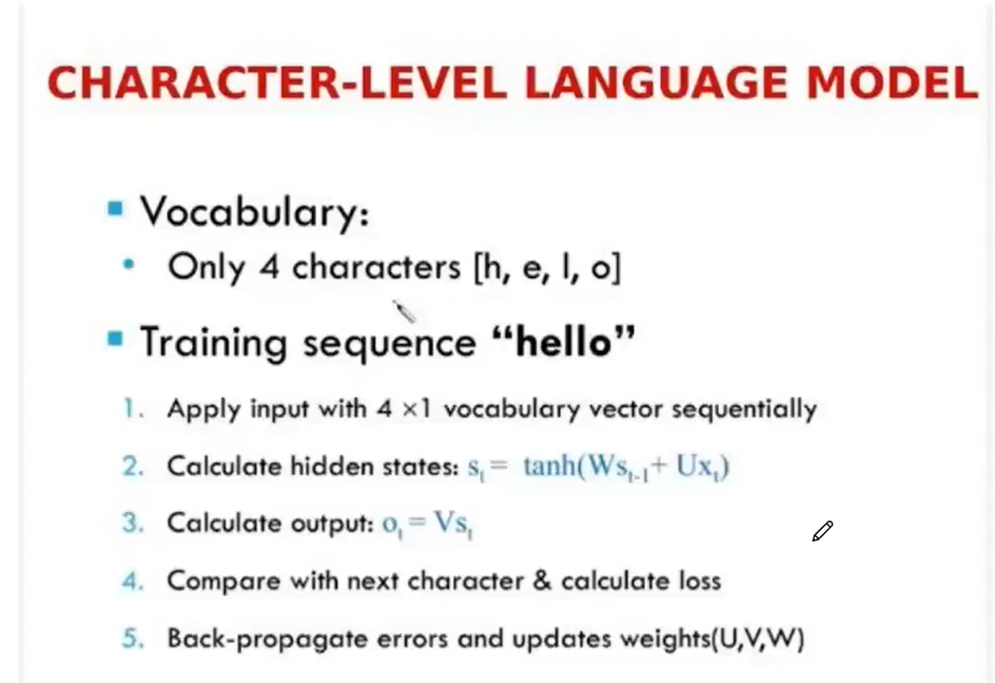

Slide 14
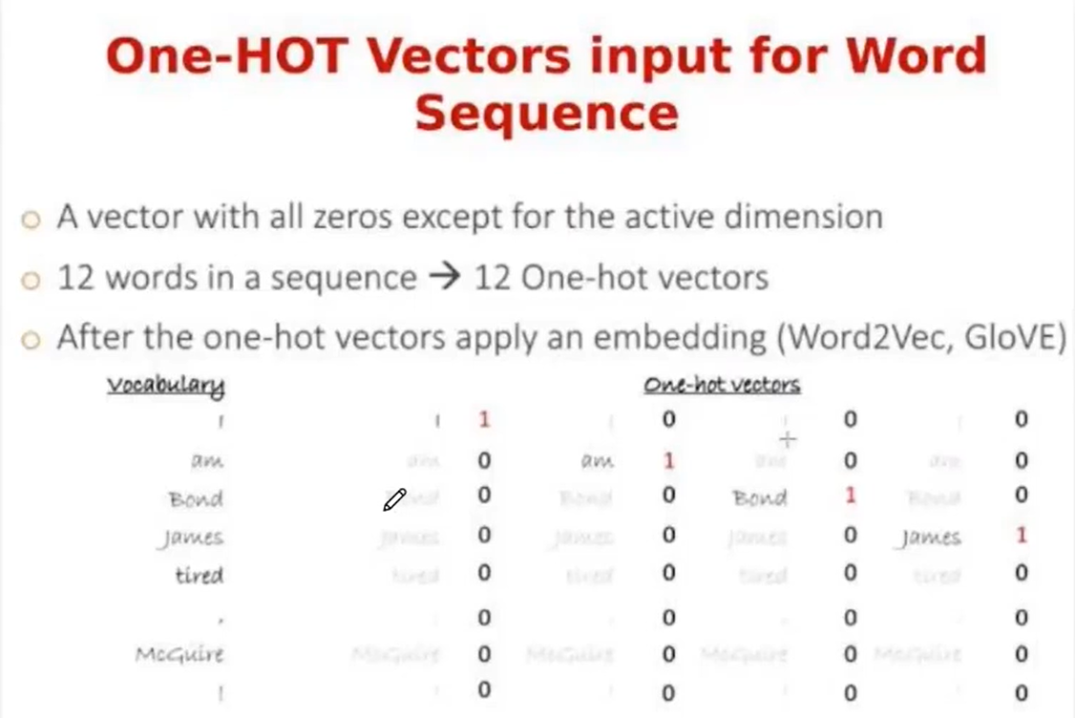

Slide 15
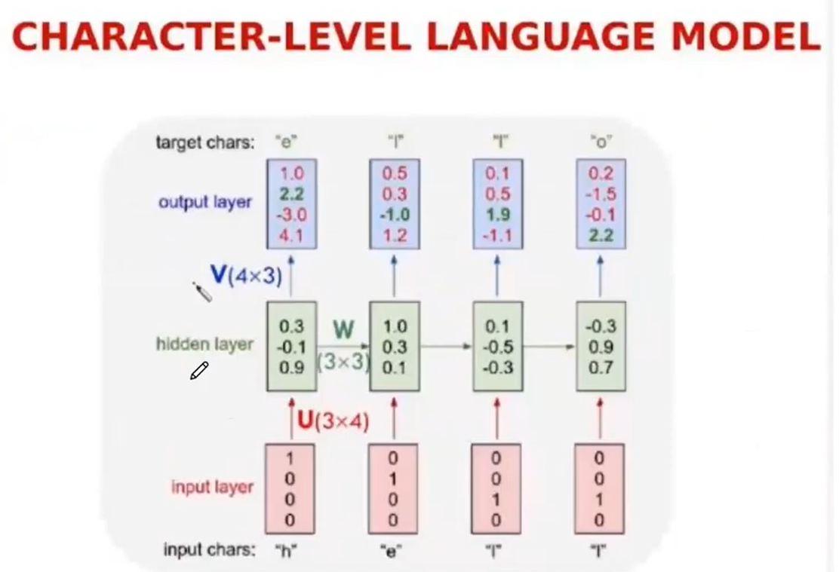

Slide 16
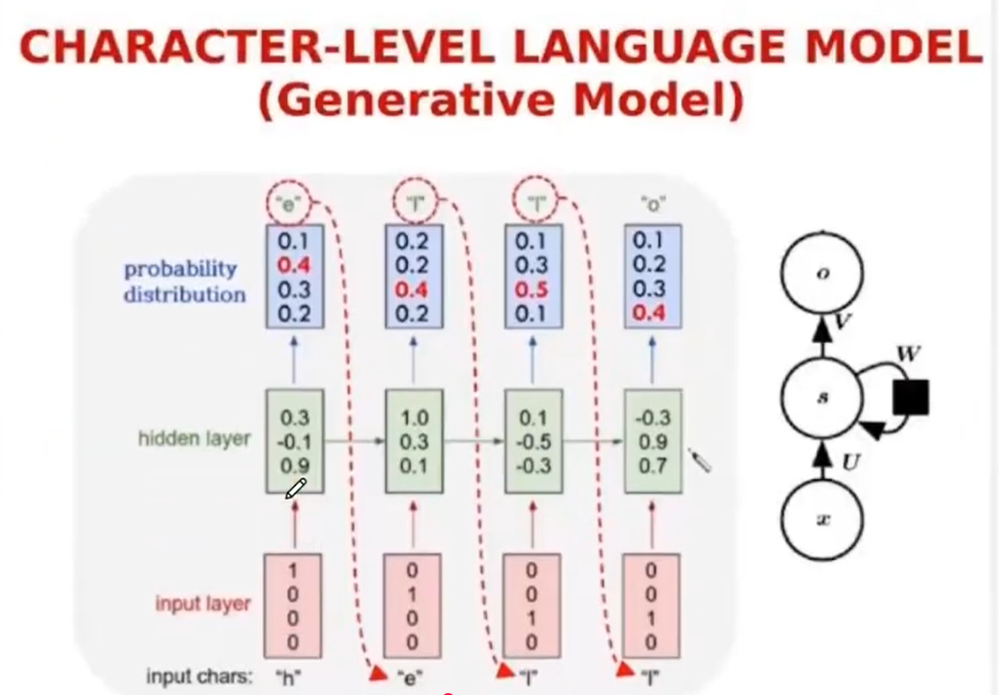

Slide 17
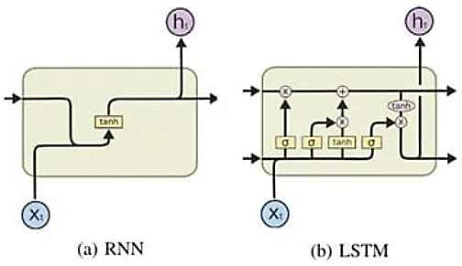

Slide 19
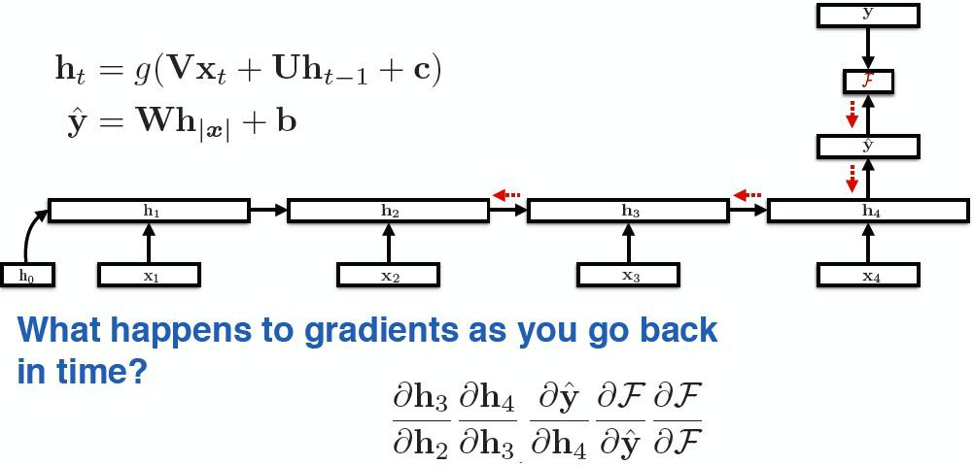
RNN training
Back-propagation over time

Slide 20
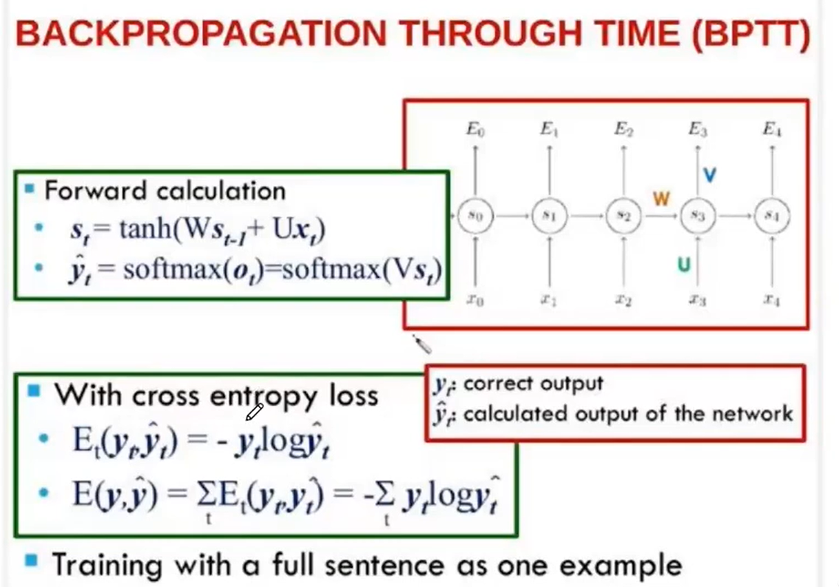

Slide 21
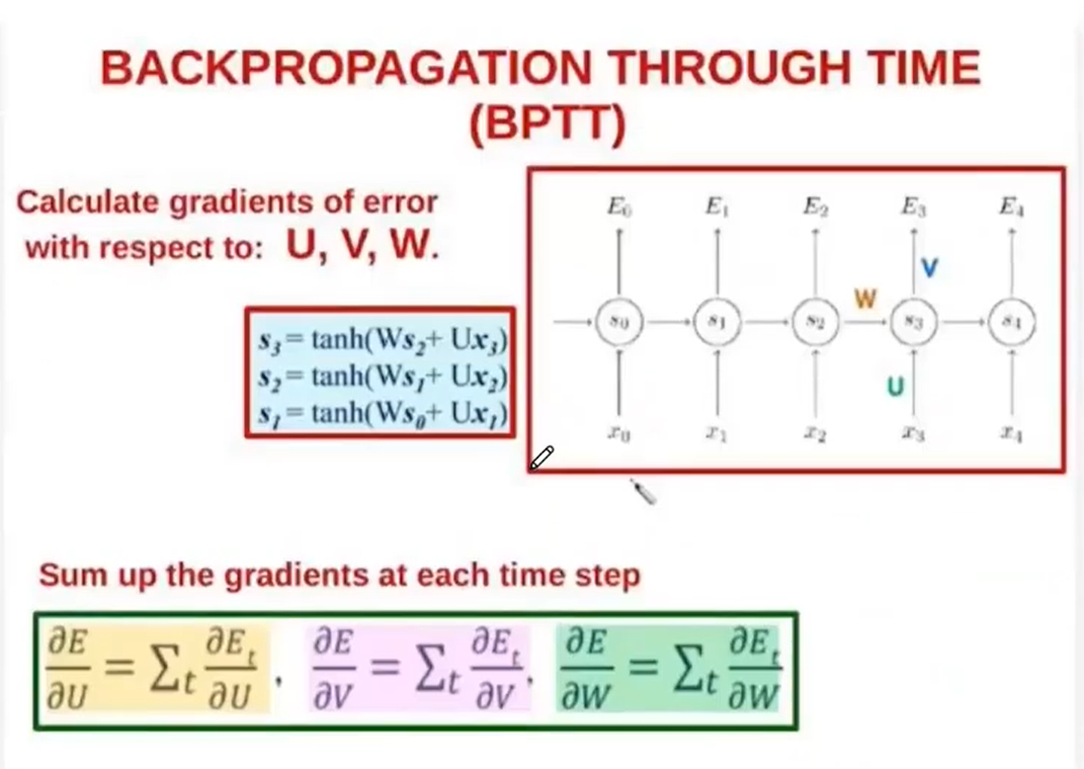

Slide 22
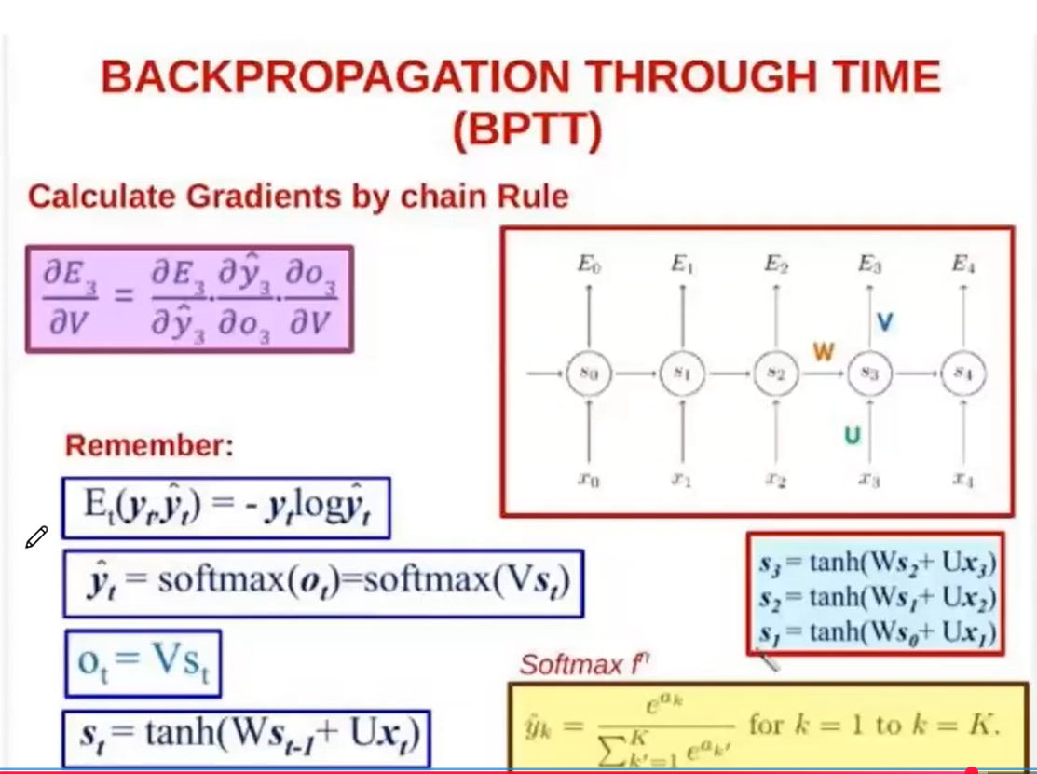

Slide 23
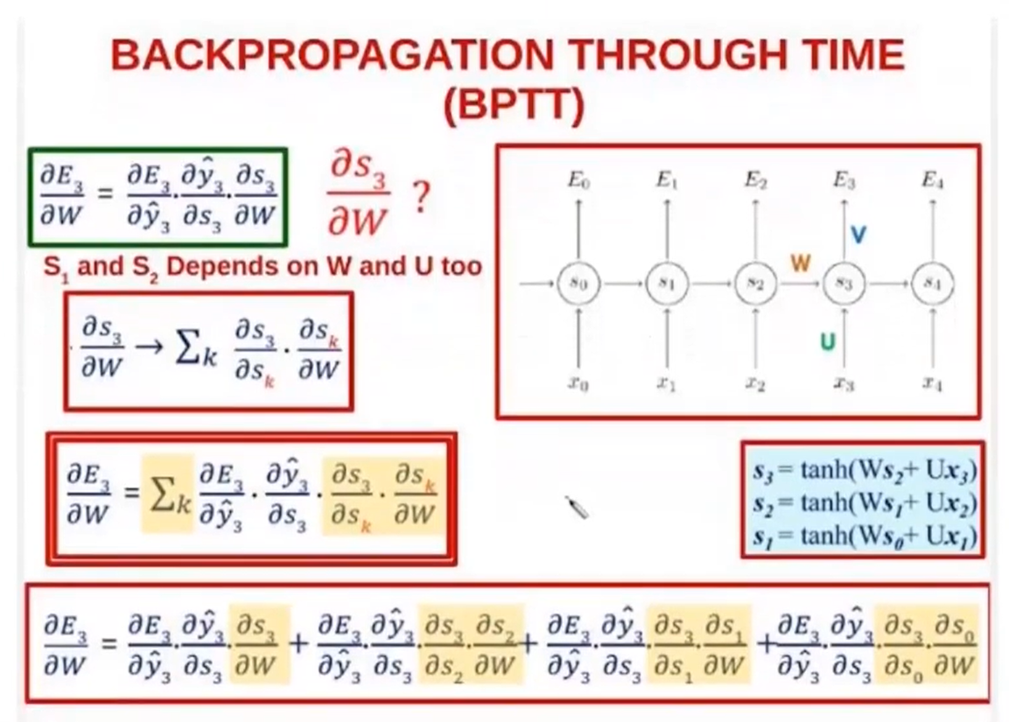

Slide 24
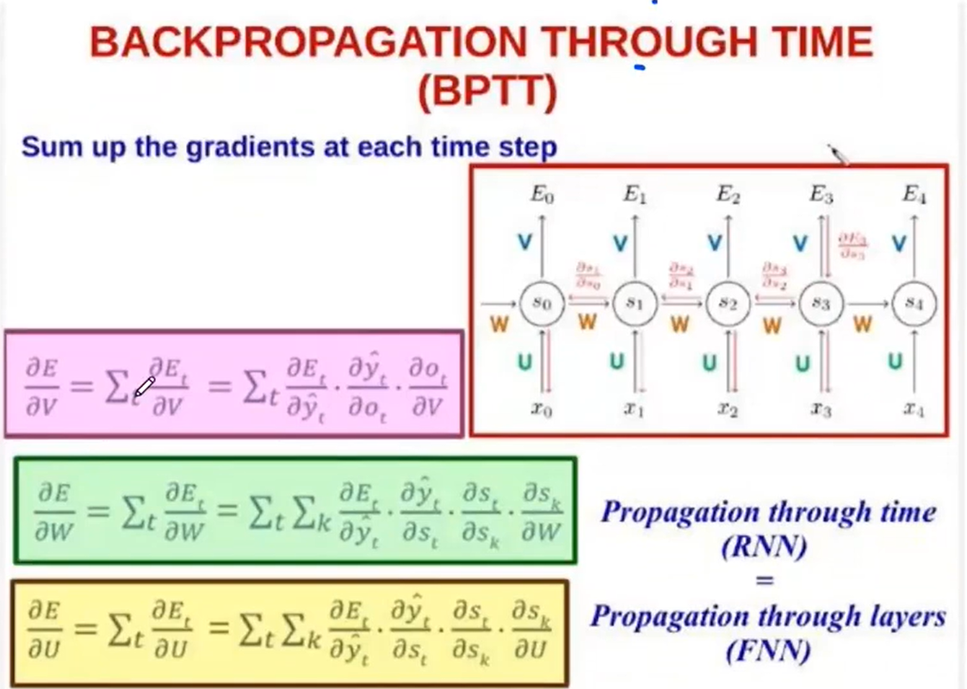

Slide 25
RNN - Problems
Slow in train
Vanishing Gradients
Hard to parallelize efficiently
Transmitting information through one bottleneck (final hidden state)
Longer sentences lose context
□Example: I was born in France .. I speak fluent French

Slide 26
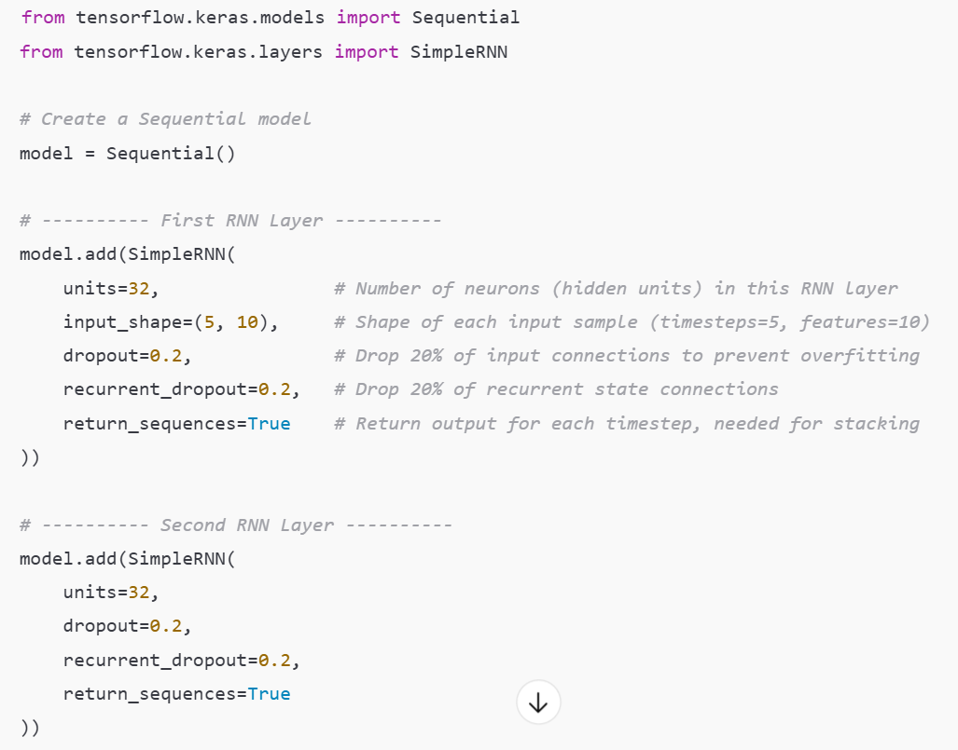
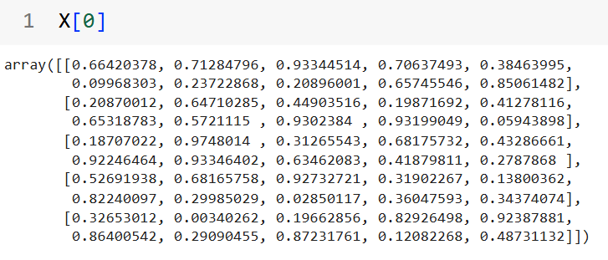

Slide 27
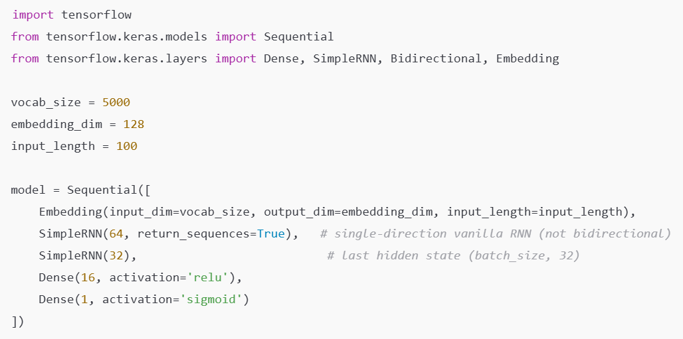

Slide 28
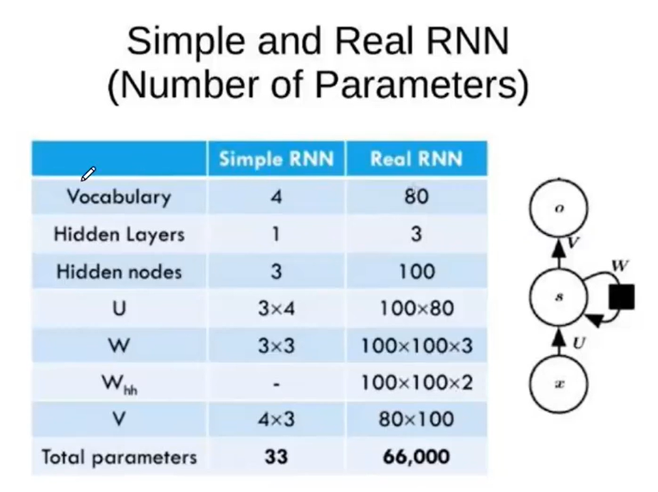

Slide 29
Deep Learning (DL)
Lab6
Natural Language Processing (NLP)
Long Short-Term Memory(LSTM)

Slide 30
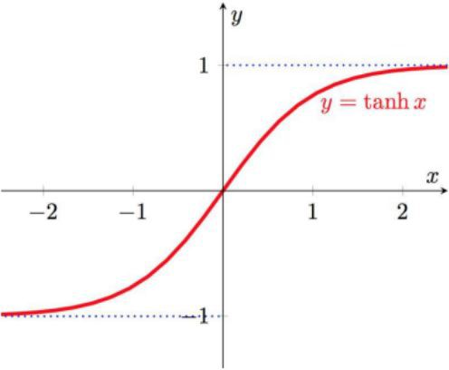
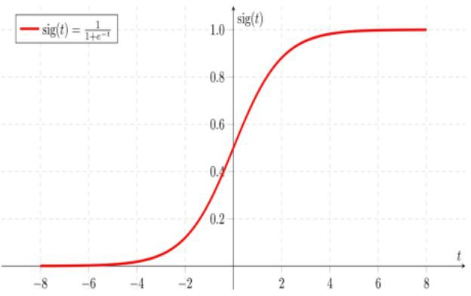
The basic difference between the function of tanh, sigmoid is the range.
إنه يقدر يخزن معلومة
مع اتجاهها
كلمة مهمة → +قيمة موجبة
كلمة نفي أو شيء سلبي → قيمة سالبة
يعني tanh مش هدفها كمية كبيرة… هدفها المعنى والاتجاه.
القيم السالبة مهمة جدًا:
توضح إذا المعلومة تعاكس أو تنفي معلومة سابقة
لأنها مثل مفتاح تحكم:
0 → انسَ كل شيء
1 → احتفظ بكل شيء
0.3 → احتفظ بجزء صغير
هي Gate تتحكم بالمعلومات نفسها، وليس محتوى الذاكرة
مثال بسيط:
“هو سعيد” → قيمة موجبة
“هو ليس سعيدًا” → النفي يظهر بقيمة سالبة

Slide 31
Long Short-Term Memory (LSTM)

Slide 32
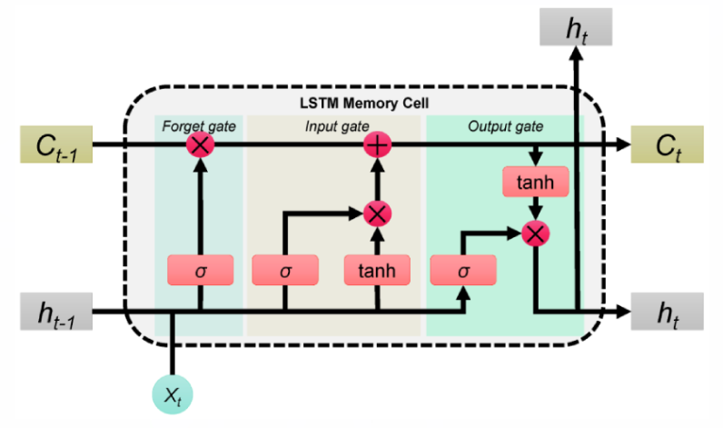
Long Short-Term Memory (LSTM)
Use gates to control the information to be added from the input, forgot from the previous memories, and outputted.
σ (sigmoid) used for gates probabilities.
Tanh functions used respectively, to map the value to [-1, 1], where they solve the problem of basic RNN.
Cell State c(t):The memory of the LSTM, updated by the forget and input gates.
Hidden State h(t): The output of the LSTM cell at the current time step, determined by the output gate and cell state.
Notes:
c(t): مخزن المعرفة على المدى الطويل؛ بيتغير ببطء وبشكل تراكمي.
h(t): الإخراج اللحظي “المرئي” للطبقات اللاحقة؛ ملخّص قصير المدى للحظة الحالية.

Slide 33
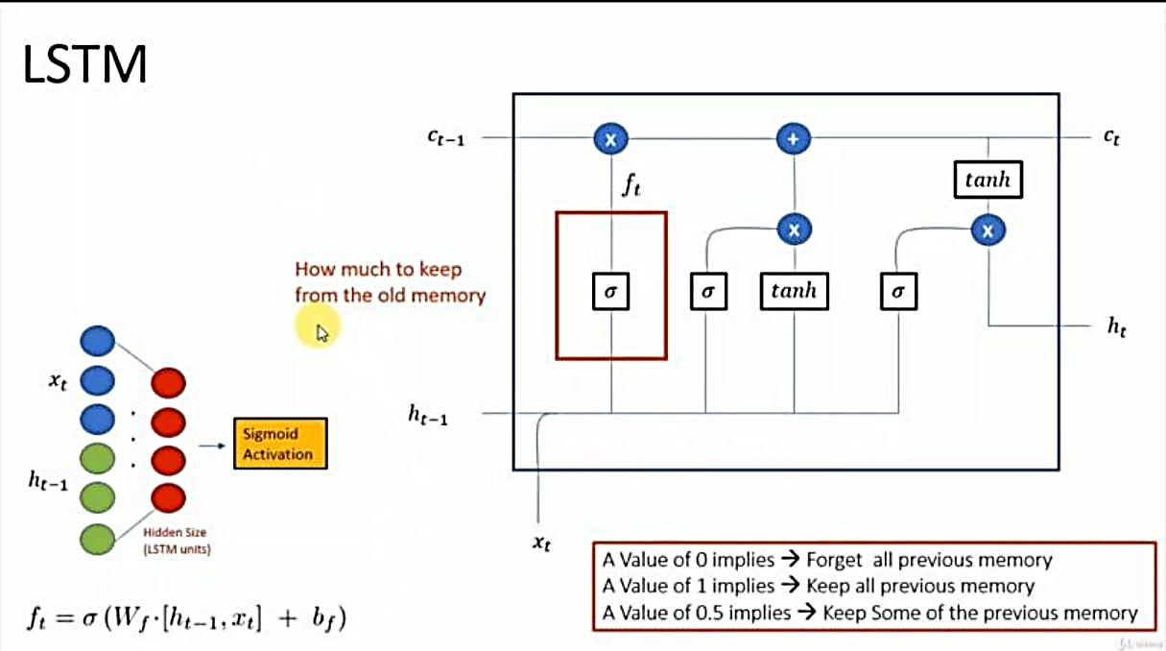
Forget Gate
In the first part, we see the sigma mark σ, which represents the gates that control the flow of data, and they control the amount of data that comes in from the old memory that comes from the former output, and if it's 0, 1, or 0.5, it controls this amount of data.

Slide 34
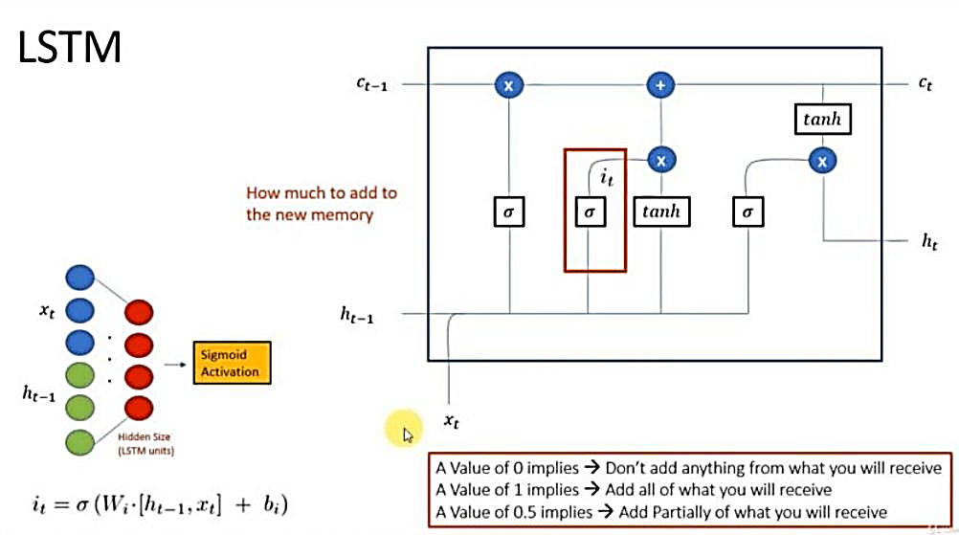
Update Gate
The next cell controls the amount of data that will be added to the next one, and it has values of 0 is 1 or 0.5 that indicate the amount of addition.

Slide 35
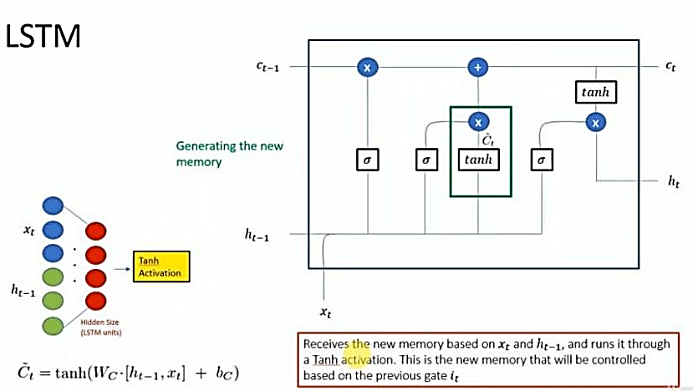
In cell number three, it's the one who's taking the data into it and making the new memory.

Slide 36
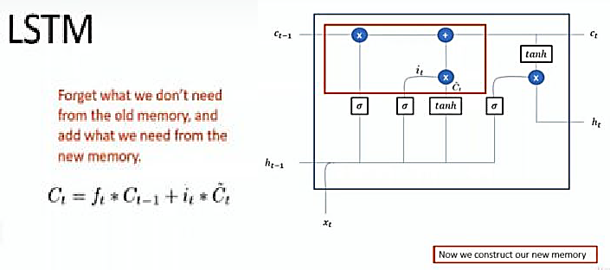

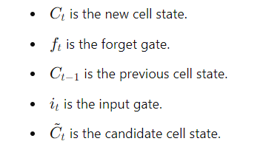
And then we design the new memory of the cell with this equation.
The image explains the LSTM memory update process:
Forget the old memory we don't need and add what we need from the new memory.
- Equation:

Slide 37
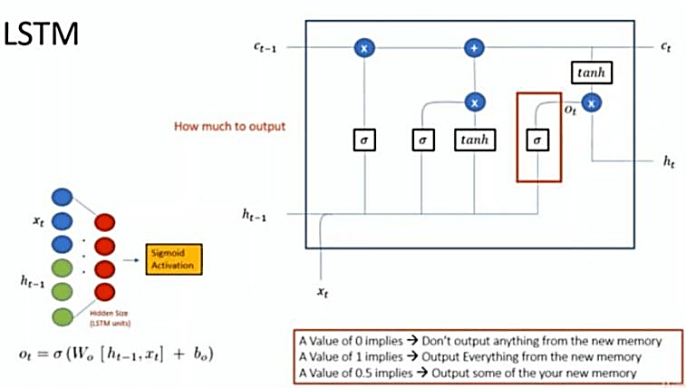
This next step is controlling the amount of output from the cell.
Output Gate

Slide 38
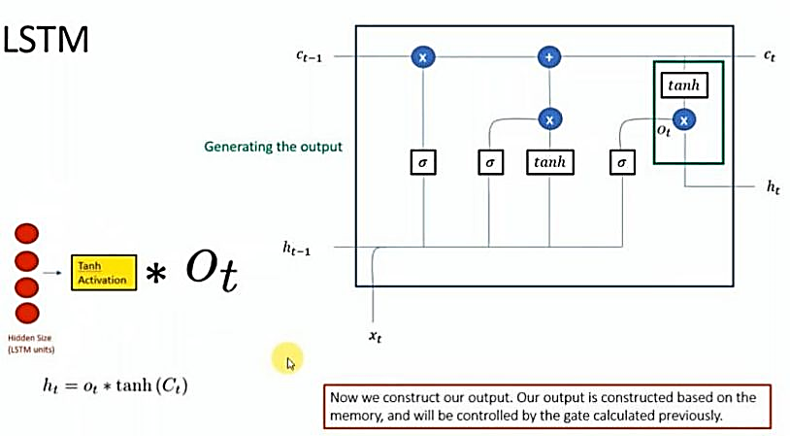
Then process and produce the output itself with the tanh equation

Slide 39
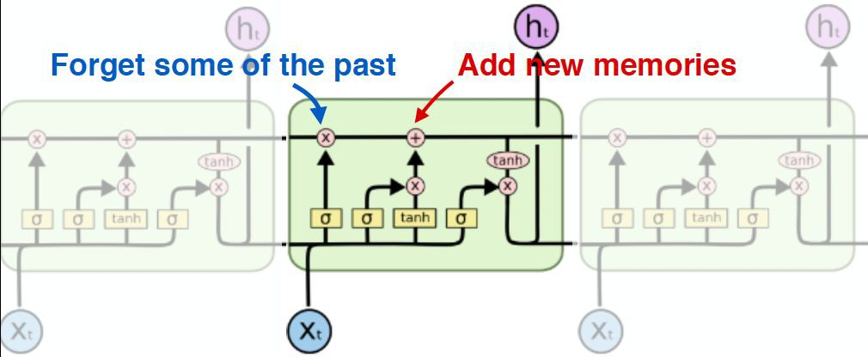
Long Short-Term Memory (LSTM)

Slide 41
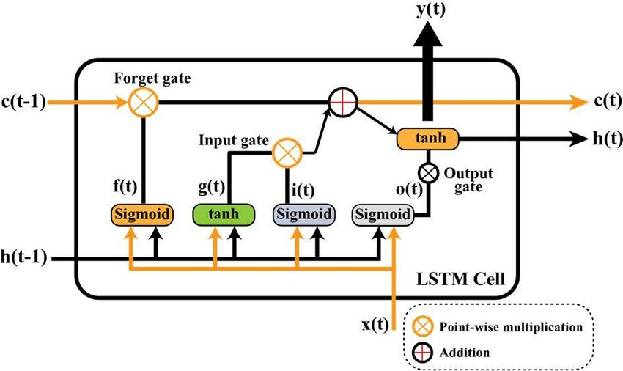
LSTM Components
67
Forget Gate f(t): Decides how much of the previous cell state
(c(t-1)) to forget, using a sigmoid function.
2. Input Gate i(t): Controls how much new information to add to the cell state, based on the current input.
3. Cell State Update g(t): Generates candidate values g(t) with a tanh function to be added to the cell state. Candidate values are the potential new information generated by the `tanh` function, which could update the cell state. Their impact depends on the input gate controlling how much is added to the memory.
يولّد الاقتراح/القيم المرشَّحة اللي ممكن نضيفها للذاكرة
4. Output Gate o(t): Determines how much of the updated cell state to output as the hidden state h(t).
5. Cell State c(t):The memory of the LSTM, updated by the forget and input gates.
6. Hidden State h(t): The output of the LSTM cell at the current time step, determined by the output gate and cell state.
7. Point-wise Multiplication (⊗): Used for element-wise operations like updating the cell state.
8. Addition (⊕): Combines the effects of forget and input gates to update the cell state.

Slide 42
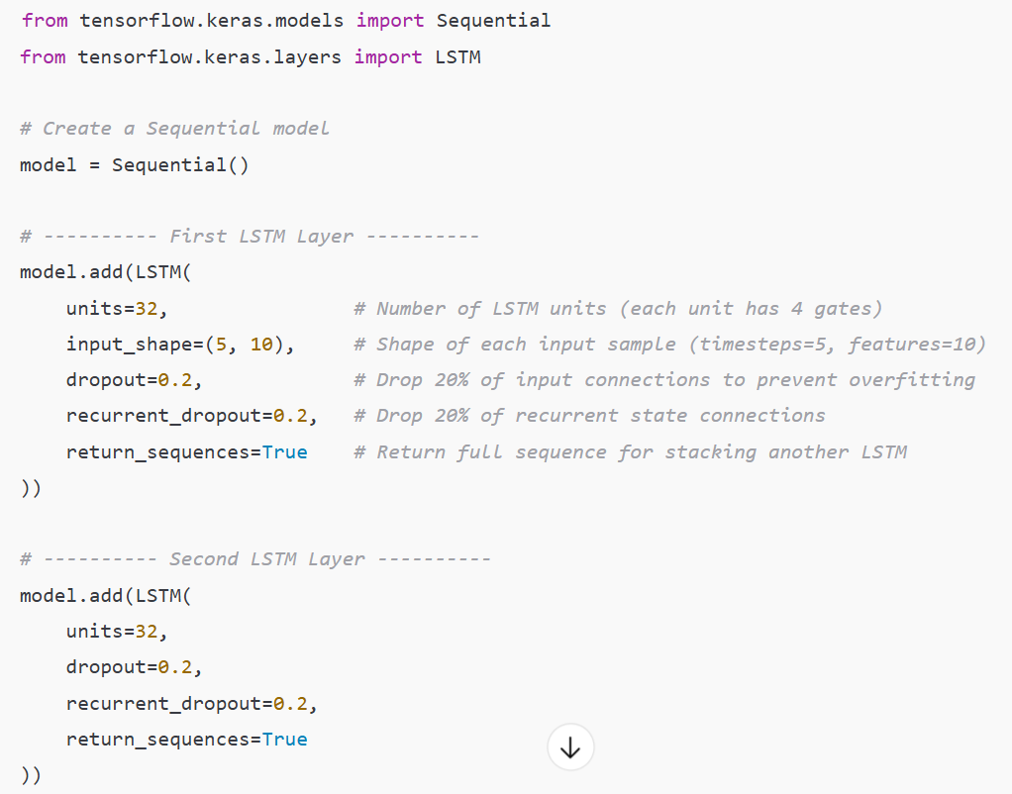

Slide 43
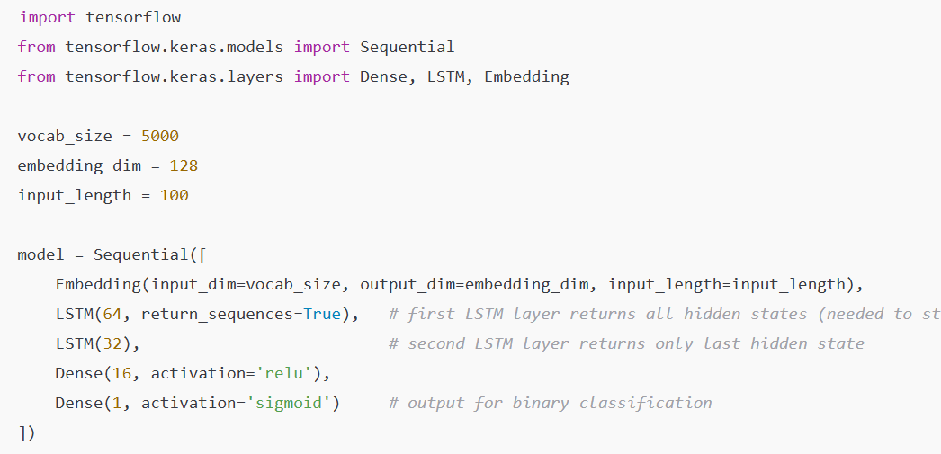

Slide 44




Slide 45
Simple RNN vs LSTM
LSTM is even more slower to train as compared to RNN
Vanishing gradient problem still persists
Sequential computation inhibits parallelization

Slide 46
Deep Learning (DL)
Lab6
Natural Language Processing (NLP)
Gated Recurrent Unit (GRU)

Slide 47
Gated Recurrent Unit (GRU)

Slide 48
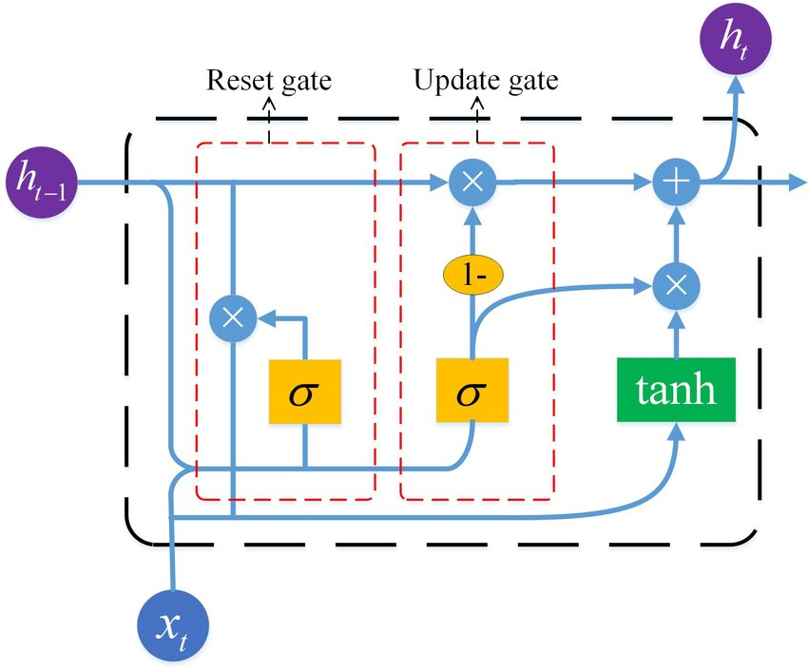
Gated Recurrent Unit (GRU)
Update Gate (z)
Controls how much past information is kept and how much new information is added.
Decides what portion of the hidden state should be updated with new input.
Reset Gate (r)
Controls how much of the past information to forget.
Helps the model reset its memory for processing new sequences.
Notes:
🧠 أولاً: الفكرة العامة
خلية الـ GRU بتحاول تحل مشكلة نسيان المعلومات القديمة أو الـ vanishing gradient اللي كانت موجودة في الـ RNN العادية. بتعمل كده عن طريق بوابات (Gates) تتحكم في المعلومات اللي تتخزن أو تتنسى.

Slide 49
Gated Recurrent Unit (GRU)
Notes:
🧠 أولاً: الفكرة العامة
خلية الـ GRU بتحاول تحل مشكلة نسيان المعلومات القديمة أو الـ vanishing gradient اللي كانت موجودة في الـ RNN العادية. بتعمل كده عن طريق بوابات (Gates) تتحكم في المعلومات اللي تتخزن أو تتنسى.

Slide 50
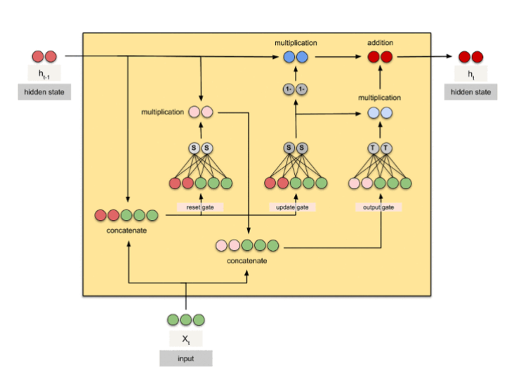
1️⃣ Inputs
At the bottom, you have:
xₜ (green circles) → current input (for example, the current word).
hₜ₋₁ (red circles) → previous hidden state (memory from the past).
These two are concatenated (joined) — that means we feed both into the GRU so it can decide what to remember or forget.
Notes:
1️⃣ المدخلات (Inputs)
عندك في الأسفل xₜ (باللون الأخضر) → ده المدخل الحالي (مثلاً الكلمة الحالية في الجملة).
وعندك في الشمال hₜ₋₁ (باللون الأحمر) → ده الـ hidden state القديم اللي جاي من الخطوة السابقة (الذاكرة السابقة).
الاتنين دول بيتجمعوا مع بعض في البداية:
⮕ concatenate (دمج) علشان الخلية تشوف المدخل الحالي ومعاه الذاكرة القديمة.

Slide 51
2️⃣ Reset Gate
The part labeled reset gate decides:
“How much of the previous memory (hₜ₋₁) should I use when creating the new candidate state?”
Mathematically:
rₜ = sigmoid(Wᵣ * [hₜ₋₁, xₜ])
The sigmoid function gives values between 0 and 1:
rₜ ≈ 0 → forget old memory
rₜ ≈ 1 → use old memory fully
⚡ Purpose: controls how much past information influences the new calculation.
Notes:
2️⃣ Reset Gate (بوابة إعادة الضبط)
شايف الجزء اللي مكتوب عليه reset gate؟
البوابة دي بتقرر:
"هل أحتاج أستفيد من الذاكرة القديمة (hₜ₋₁)؟ ولا أبدأ من جديد؟"
المعادلة تقريبًا هي:
rₜ = sigmoid(Wᵣ * [hₜ₋₁, xₜ])
الناتج (rₜ) قيم بين 0 و 1:
لو قريب من 0 → ننسى الذاكرة القديمة.
لو قريب من 1 → نستخدمها بالكامل.
⚡ الهدف: التحكم في "كمية الماضي" اللي هندخلها في الحسابات الجديدة.

Slide 52
3️⃣ Update Gate
The update gate decides:
“Should I keep the old memory or replace it with the new one?”
Equation:
zₜ = sigmoid(W_z * [hₜ₋₁, xₜ])
zₜ ≈ 0 → use mostly new information
zₜ ≈ 1 → keep old information
⚡ Purpose: controls how much of the new vs. old hidden state will appear in the output.
Notes:
3️⃣ Update Gate (بوابة التحديث)
الجزء المكتوب عليه update gate بيحسب:
zₜ = sigmoid(W_z * [hₜ₋₁, xₜ])
دي بتتحكم في "هل أحتفظ بالمعلومة القديمة ولا أبدلها بالجديدة؟"
قيمها بين 0 و 1:
0 → تجاهل القديم، استخدم الجديد.
1 → حافظ على القديم كما هو.
⚡ الهدف: تعمل "توازن" بين الذاكرة القديمة والجديدة.

Slide 53
4️⃣ Candidate Hidden State
Then we build a candidate hidden state (h̃ₜ) — the potential new memory. We first multiply the reset gate by the old hidden state, so only part of it is used:
h̃ₜ = tanh(W * [rₜ ⊙ hₜ₋₁, xₜ])
⚡ Purpose: create a “new memory proposal” that combines the current input and part of the past.
Notes:
4️⃣ Candidate Hidden State (الحالة الجديدة المقترحة)
بعد الـ reset gate، ندمج rₜ ⊙ hₜ₋₁ (يعني نضربهم عنصر بعنصر) مع xₜ عشان نولد مرشح الحالة الجديدة:
h̃ₜ = tanh(W * [rₜ ⊙ hₜ₋₁, xₜ])
⚡ الهدف: توليد نسخة جديدة محتملة من الذاكرة — لكن مش بالضرورة نستبدل القديمة بيها بالكامل.

Slide 54
5️⃣ Final Hidden State
Finally, the GRU blends the old memory and the new candidate using the update gate:
hₜ = (1 - zₜ) ⊙ h̃ₜ + zₜ ⊙ hₜ₋₁
So:
If zₜ is near 1 → keep old memory
If zₜ is near 0 → replace with new one
⚡ Purpose: smartly update memory without losing important long-term context.
Notes:
5️⃣ Final Hidden State (الحالة النهائية الجديدة)
دلوقتي بنستخدم update gate لدمج القديم والجديد:
hₜ = (1 - zₜ) ⊙ h̃ₜ + zₜ ⊙ hₜ₋₁
المعنى:
لو zₜ ≈ 1 → نحافظ على الذاكرة القديمة (ننسى الجديد)
لو zₜ ≈ 0 → نستخدم الذاكرة الجديدة
⚡ الهدف: تحديث الذاكرة بطريقة ذكية — بحيث نحافظ على المهم ونستبدل الباقي

Slide 55
🎯 The Goal
GRU learns:
When to remember old information
When to forget
When to update
That’s why GRUs are powerful for sequences like text or video — they don’t forget long-term dependencies like vanilla RNNs do.
Notes:
🎯 الهدف العام
خلية GRU بتتعلم مع الوقت:
متى تتذكر المعلومات القديمة؟
متى تمسحها وتتعلم جديدة؟
وده بيخليها ممتازة في التعامل مع الجمل الطويلة أو الفيديوهات، لأنها مش بتنسى بسهولة زي الـ RNN العادية.

Slide 57
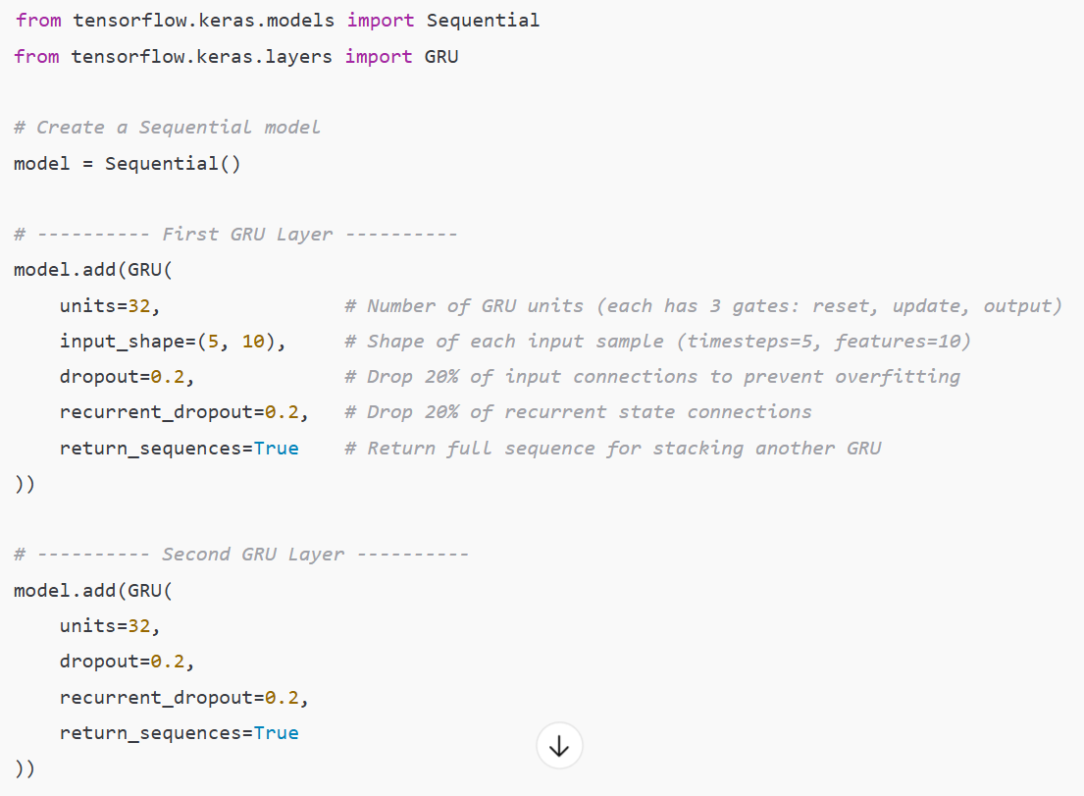
67

Slide 58
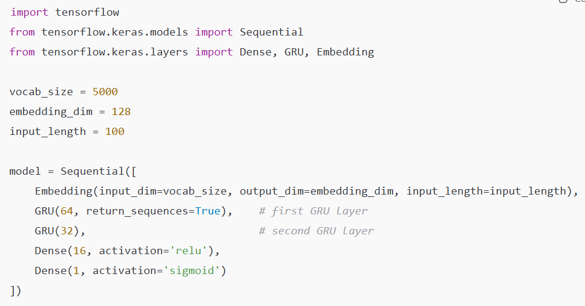
67

Slide 59
Here's a brief comparison of LSTM and GRU:
67
1. Gates:
- LSTM has three gates (forget, input, output).
- GRU has two gates (update, reset).
2. Cell State:
- LSTM has a separate cell state.
- GRU combines the cell state with the hidden state.
3. Complexity:
- LSTM is more complex but offers finer control.
- GRU is simpler and faster.
4. Memory Retention:
- LSTM is better for long-term dependencies.
- GRU performs similarly but may not be as effective for very long sequences.
5. Performance:
- LSTM is more powerful but slower.
- GRU is more efficient and faster to train.

Slide 60
Deep Learning (DL)
Lab6
Natural Language Processing (NLP)
Bidirectional LSTM

Slide 61
Bidirectional LSTM

Slide 62
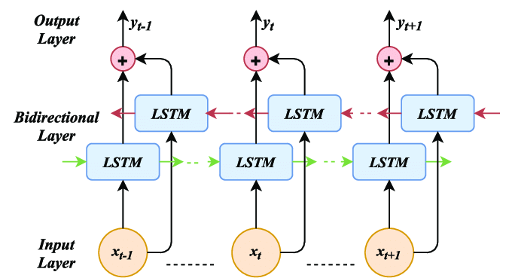


Bidirectional LSTM
Bidirectional LSTM (Bi-LSTM): Extends LSTMs by processing sequences in both forward and backward directions. It combines the outputs of two LSTM layers—one for forward and one for backward passes—to capture context from both directions.
Forward Pass: Processes the sequence from start to end, updating hidden states and memory cells at each step.
Backward Pass: Processes the sequence in reverse, updating hidden states and memory cells similarly.
Combining States: Outputs from forward and backward layers are merged (e.g., concatenated) to provide a comprehensive representation of the sequence.

Slide 63
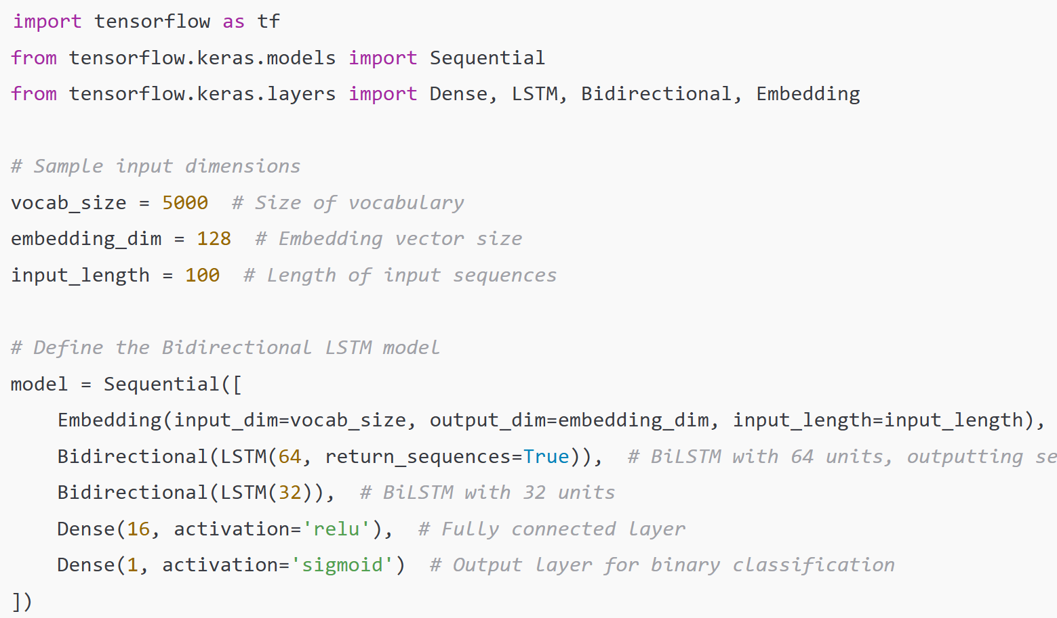
67

Slide 64
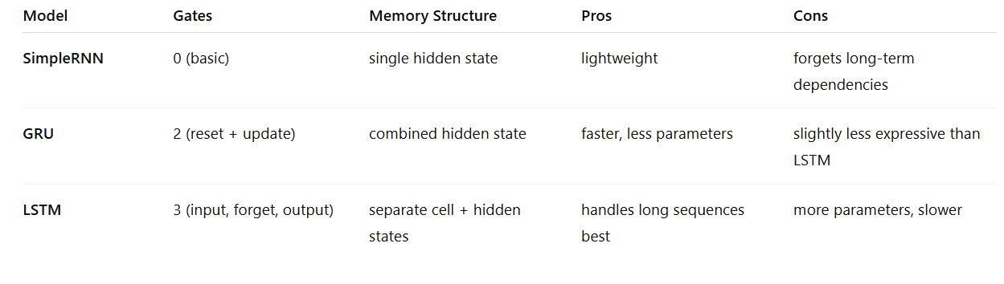
⚖️ Quick Comparison

Slide 65
https://youtu.be/0VMbGsg4LCs?si=Sendb-kUvJPZJCHy
https://youtu.be/7Zz-hQfp5xM?si=DrBV9O2r7jTQFX3U
https://youtu.be/dfTD6eeMZHE?si=GhQtLee--Ybouhqh
https://youtu.be/qWcTretvSVQ?si=H-XmRr4pZixiCtVW
https://youtu.be/n4VOB733v98?si=Dh1DEg4Q9XGj6tAe
https://youtu.be/s2x_NMayknc?si=deQpQIWacioX6phF

Slide 66
Thanks

